Slide 1

Who work in Paris? A spatial-temporal analysis of the commuting patterns of working households living in and outside the Ile-de-France Région
Phd student: Kang Liang
supervised by Fabien Leurent and co-supervised by Rémy Le Boennec
3 Dec, 2024

Slide 2
Plan
1
2
3
Introduction
Background, research questions, state of the knowledge, research hypotheses, presentation objectives
Methodology
Data and method
Result
Origin of the commuters, distance travelled, impact on the network
4
5
Conclusion
Responses to the questions and takeaway
Related work
Complementary data and temporal analysis

Slide 3
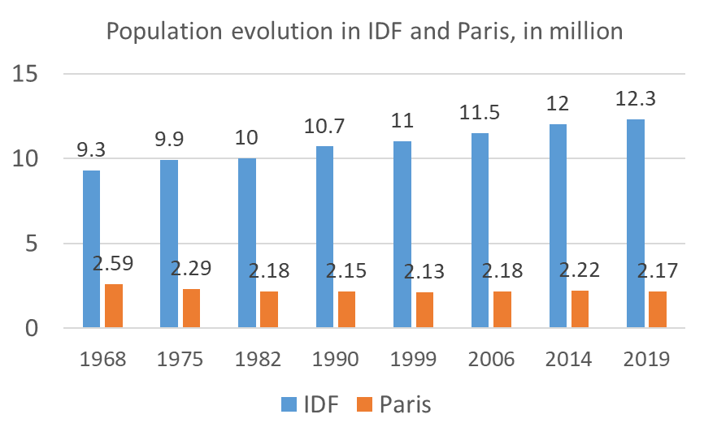
Background: Paris-Ile de France as a geographic metropolis
Settlement in space, 4 scales with increasing density:
IDF region is 12,000 km² for 12M people=> average density of 1,000 p/km²,
Paris urbanized area of 2,800 km² for 11 M people => about 4,000 p/km²,
“Grand Paris administrative Metropolis”, 7 M people on 700 km² => 10,000 p/km²,
Paris city, 2 M people on 100 km² = 20,000 p/km².
 | IDF | France | % IDF
Population | 12.3 million | 67.1 million | 18%
Jobs | 5.8 million | 28.1 million | 21%
GDP | 726 billion € | 2 353 billion € | 31%
Table_1. Summary of information of IDF and France, Data in 2019
Fig.1 Population evolution in IDF and Paris between 1968 and 2019
1
2
3
4
5
Introduction
Methodology
Result
Conclusion
Related work

Slide 4
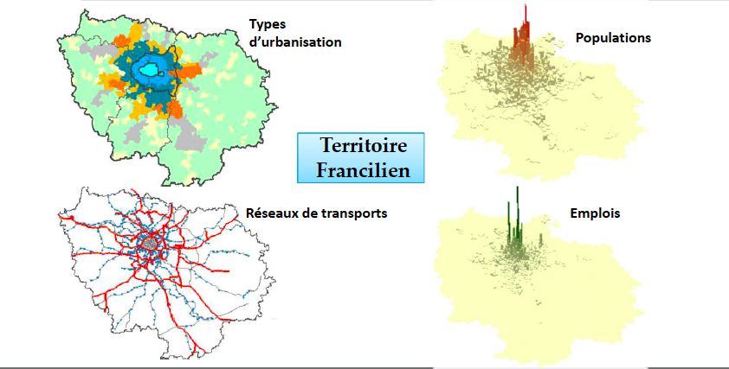
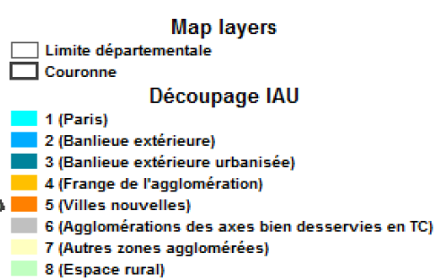
Territorial diagnosis within the IDF: 4 major aspects
Structure of the build-up areas
Populations
Complicated urban system but highly concentrated job&pop
Transport networks
Jobs
The Paris region
1
2
3
4
5
Introduction
Methodology
Result
Conclusion
Related work

Slide 5
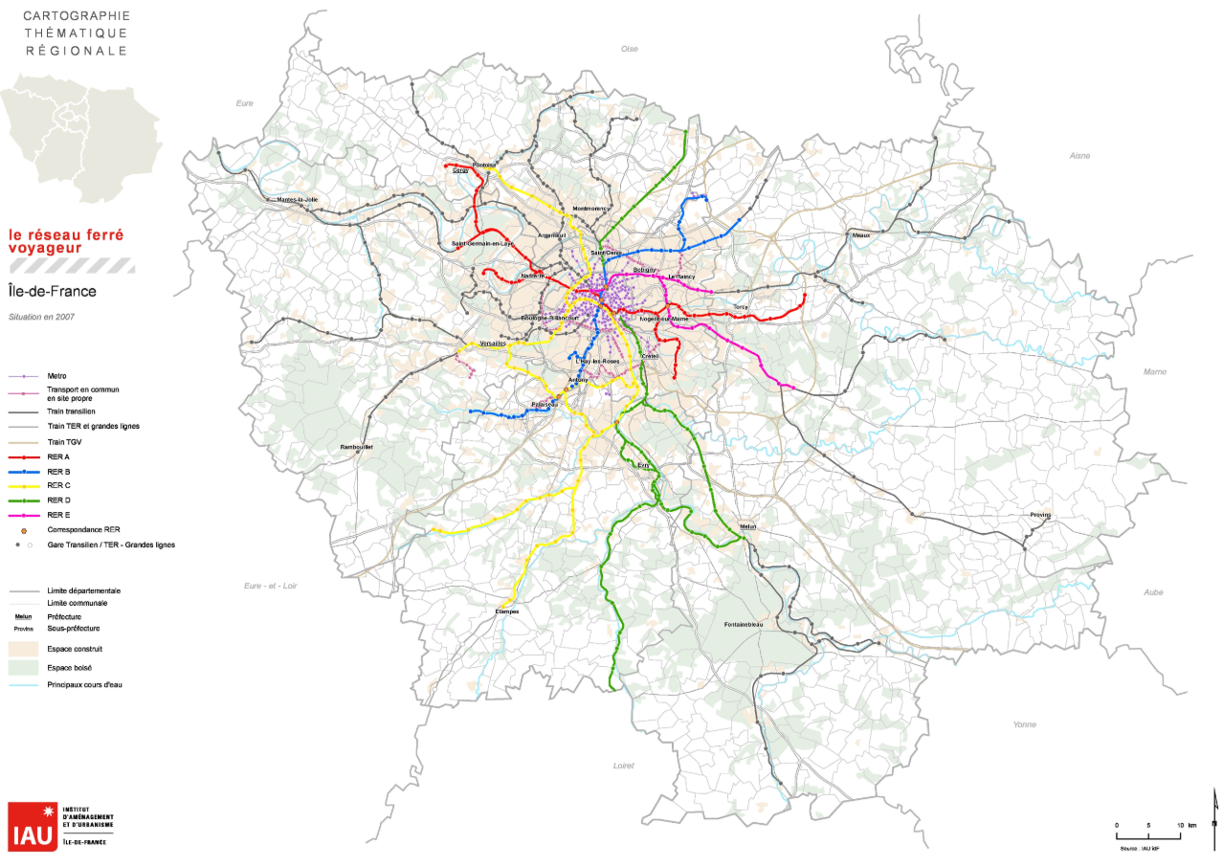
DEP | dep_job | dep_pop
75 | 1,83M | 2,18M
77 | 463K | 1,43M
78 | 529K | 1,47M
91 | 446K | 1,31M
92 | 964K | 1,64M
93 | 583K | 1,65M
94 | 518K | 1,41M
95 | 421K | 1,25M
total | 5,76M | 12,4M
Table_2 Job&pop in IDF as of 2018
Rail system in IDF
1
2
3
4
5
Introduction
Methodology
Result
Conclusion
Related work

Slide 6
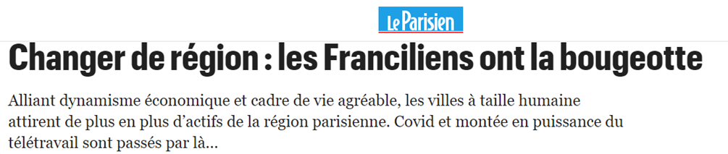
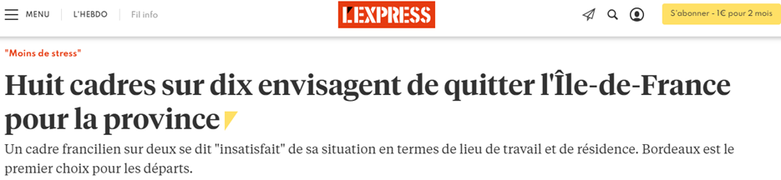
Background: IDF attraction on workers
Ile-de-France boasting an impressive 5.8 million jobs.
6.5% or approximately 373,000 workers—reside outside the region: the “outsiders”.
The region endeavors to attract international firms and their workers – yet many of its households consider relocating from IDF to other regions to get a higher quality of life.
1
2
3
4
5
Introduction
Methodology
Result
Conclusion
Related work

Slide 7
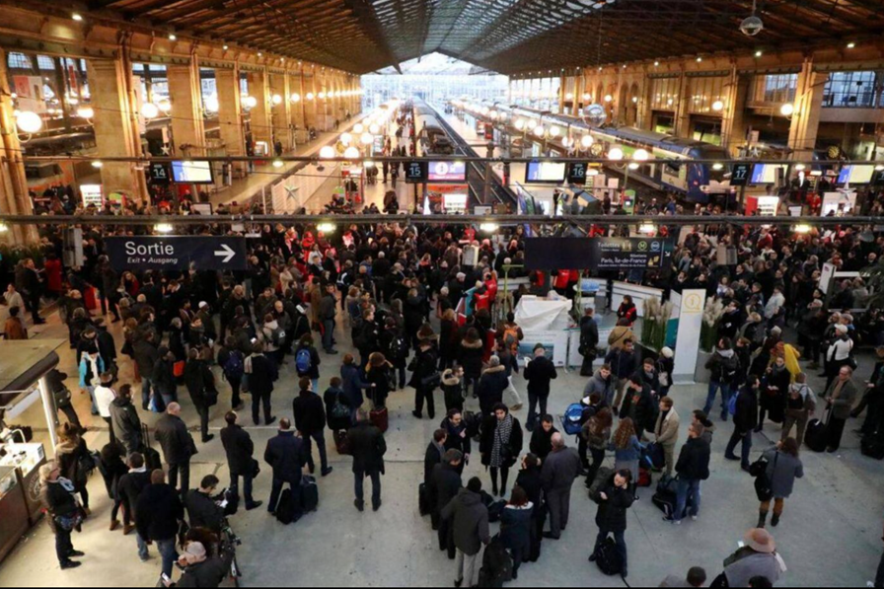
Research questions:
Where do IDF workers live? How far away from Paris? Do they live in or outside the IDF region?
What are the commuting distances travelled respectively by the insiders and the outsiders ? What is the share of the outsiders in the total distances travelled?
Is the modal split of “outsiders” commuting trips comparable to that of “insiders”?
1
2
3
4
5
Introduction
Methodology
Result
Conclusion
Related work

Slide 8
State of knowledge
1
Definition of long distance commuting (LDC) varies among countries: e.g. 50 miles in USA(U.S. Census Bureau, 2005) and 200 kilometers in Sweden (Ohman, 2003).
2
In France, long-distance commuting was mostly studied in relation to land use: residential location patterns (Zaninetti, 1999; Ravalet et al., 2014), urban forms (Aguilera and Mignot, 2004; Aguilera and Voisin, 2014) or urban systems (Conti, 2017, 2019).
3
Socio-economic implications of LDC concern household work-life balance(Viry et al., 2010), inequality(Collet and Bonnet,2010) , energy consumption(Bischoff et al, 2019) etc.
1
2
3
4
5
Introduction
Methodology
Result
Conclusion
Related work

Slide 9
Research hypotheses
The IDF region follows a monocentric pattern: the further away from the center, the less commuters;
Within IDF, the home-to-work (H2W) distances are shorter than inter-regional travels;
Inter-regional H2W travels differ from the intra-regional counterparts in their mode share, marked by higher share of motorized modes, notably trains.
Objectives
Locate the origins of workers who occupy IDF jobs, especially outsiders.
Get the distance travelled by mode, for insiders and outsiders.
Evaluate the impacts of travels related with IDF jobs
1
2
3
4
5
Introduction
Methodology
Result
Conclusion
Related work

Slide 10
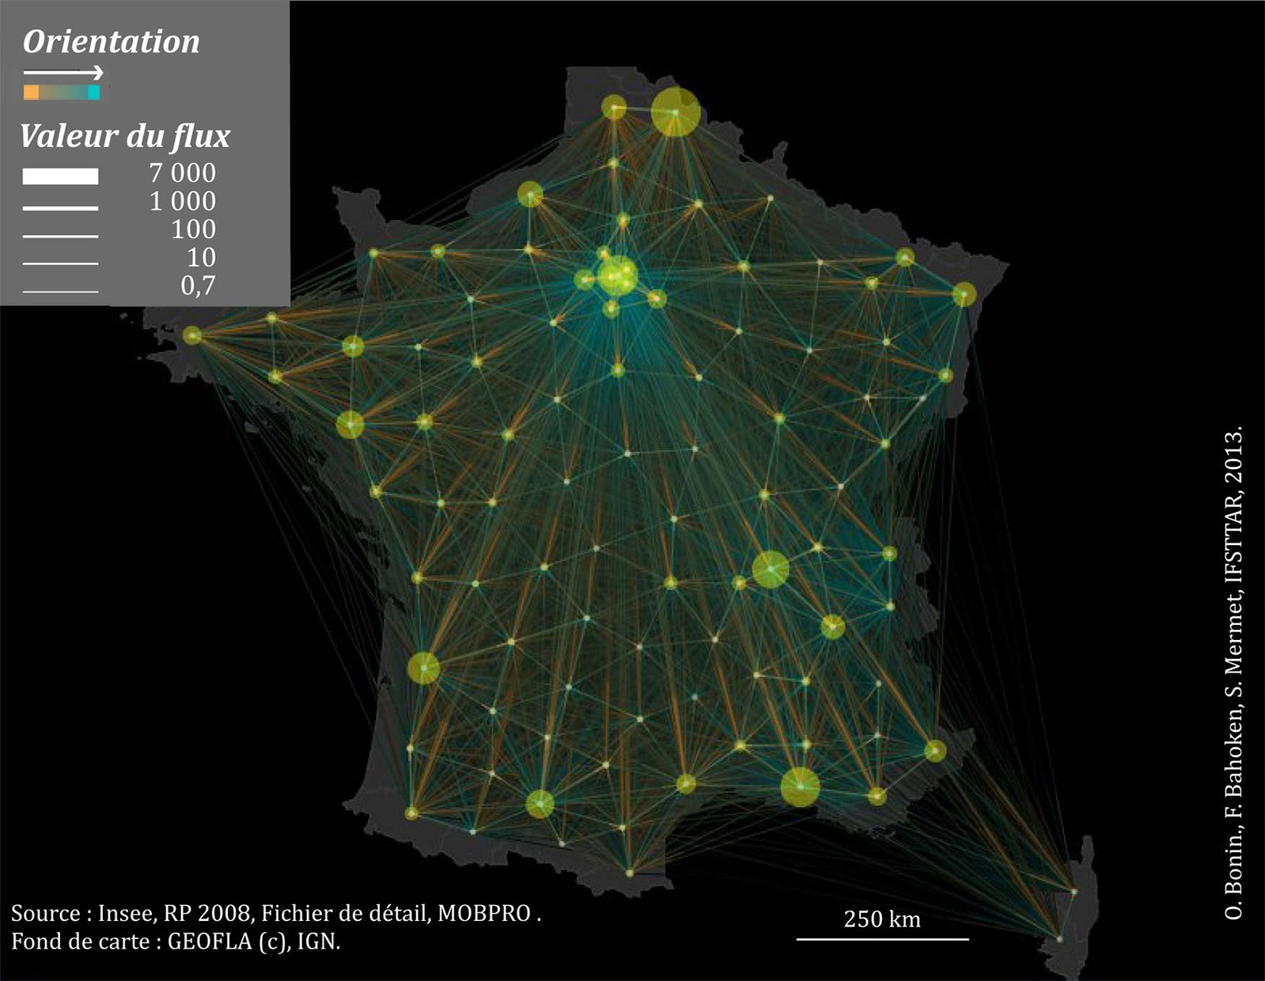
Data and method
Databases: MobPro of the 2018 French census data
Data of interest: employed workers, home place (by municipality), work place (by municipality), home2work crow-fly distance, travel mode of commuting (car / transit / cycle / walk)
Method:
Statistical treatment on a municipality level;
Spatial analysis based on a radio-concentric zoning system including 8 disjoint rings from center (Paris) to periphery.
Illustration of Mobpro 2008, Bonin et al., 2013
1
2
3
4
5
Introduction
Methodology
Result
Conclusion
Related work

Slide 11
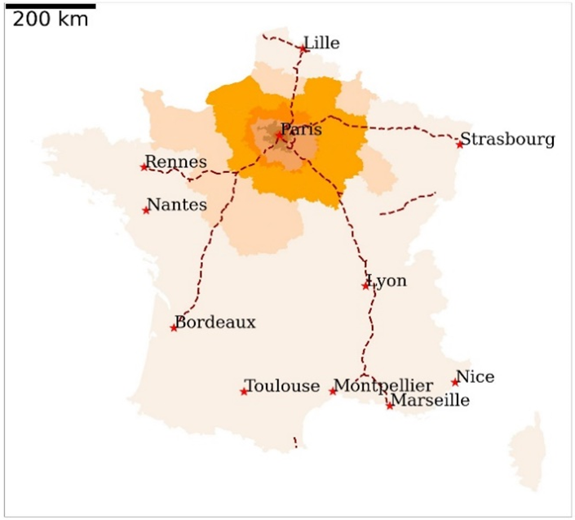
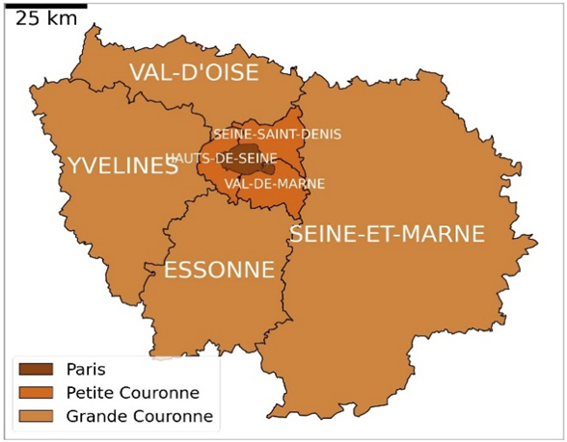
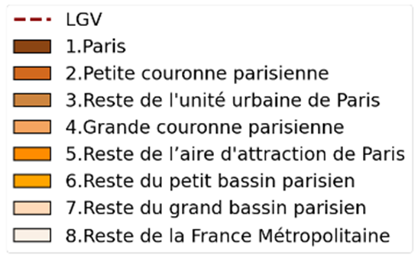
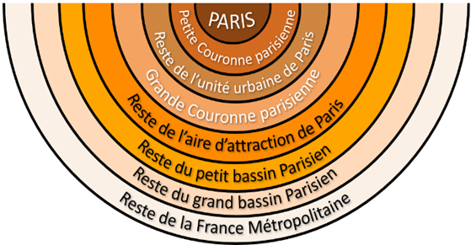
Breakdown of IDF jobs according to workers' zones of residence
 | Zone residence
1 Paris city | 18%
2 Inner ring | 35%
3 Rest of urbanized area | 30%
4 Rest of IDF region | 10%
5 Rest of P. Urban Area | 3%
6 Inner Parisian Basin | 1%
7 Outer Parisian Basin | 0%
8 Rest of France | 2%
Fig.2 The 8 concentric rings
Table_3. IDF jobs origin w.r.t workers from each ring
1
2
3
4
5
Introduction
Methodology
Result
Conclusion
Related work

Slide 12
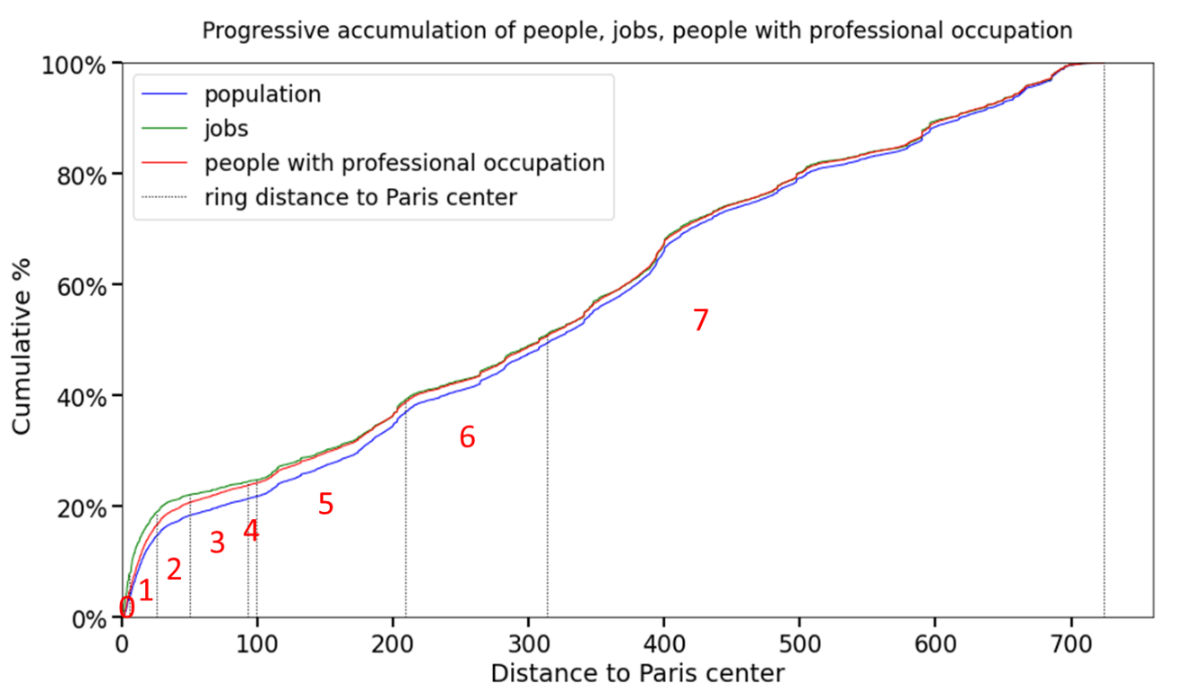
Monocentric pattern of IDF region
The progressive accumulation of jobs starting from Paris center is quicker than that of people.
The first rings concentrate an higher share of jobs than those of people, on the one hand, or those of people with a professional occupation, on the other hand.
The monocentric pattern of job locations, even more biased to the center than population is typical of a monocentric city model in urban economics.
Fig.3 Accumulation of population, jobs according to concentric rings
1
2
3
4
5
Introduction
Methodology
Result
Conclusion
Related work

Slide 13
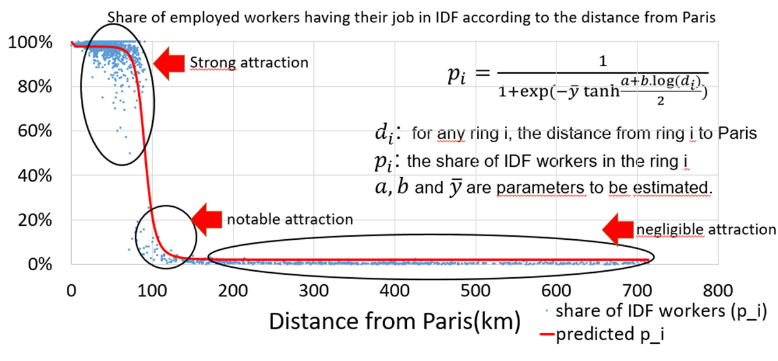
Share of IDF jobs by origin
 | share from zone of origin
1 Paris city | 98%
2 Inner ring | 99%
3 Rest of urbanized area | 99%
4 Rest of IDF region | 97%
5 Rest of P. Urban Area | 41%
6 Inner Parisian Basin | 5%
7 Outer Parisian Basin | 2%
8 Rest of France | 1%
Fig.4 Function describing the share of IDF workers according to distance from Paris
Table_4. Share per origin ring of IDF worker w.r.t from each ring
1
2
3
4
5
Introduction
Methodology
Result
Conclusion
Related work

Slide 14
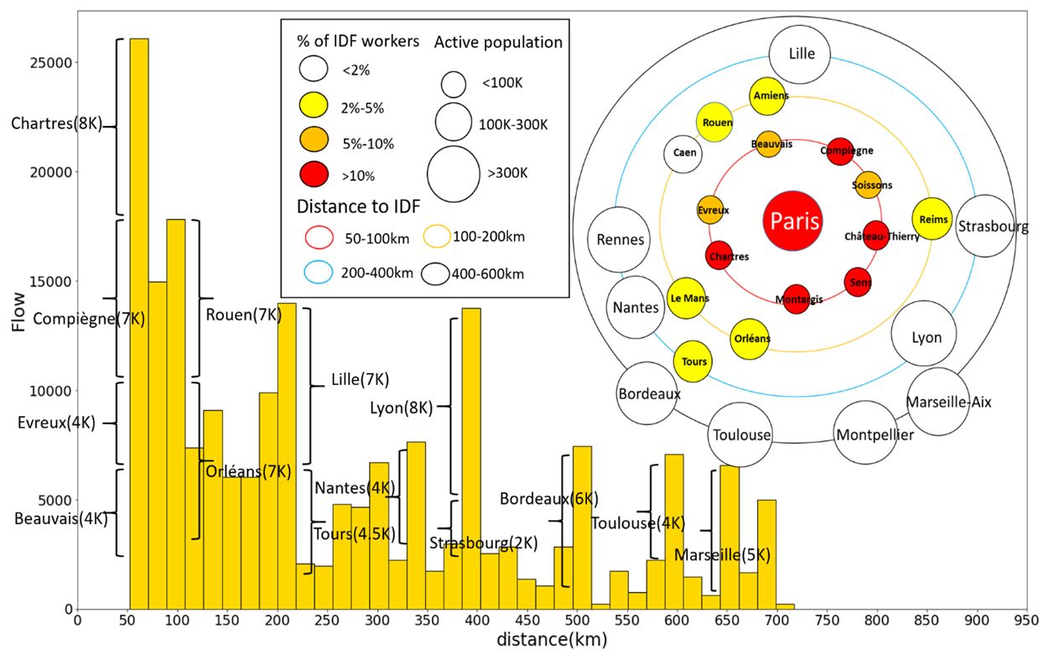
Home cities and commuting ranges
Histogram:
Abscissa : Rings of 20 km width starting from 50 km
Ordinate: the flows of commuters.
The bumps in the distribution: mostly due to specific urban areas.
Star & Satellite diagram:
The proportion of the IDF employed workers among all employed workers in their home urban area varies from:
1 or 2% in the farthest cities, e.g. Lyon
4% at 200 km, e.g. Reims
10% in the closest cities, e.g. Chartres
Fig.5 Histogram / star & satellite diagram
1
2
3
4
5
Introduction
Methodology
Result
Conclusion
Related work

Slide 15
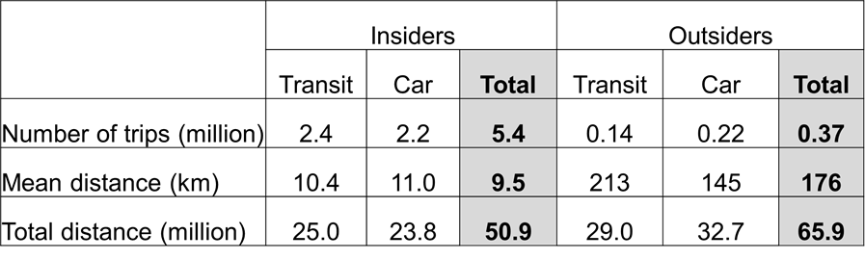
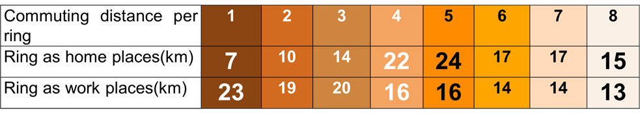
Commuting distances
Origin-based average distances: 10km : 176km
The share of outsiders in the global average: 66/(66+51)≈56%
2. Destination-based average commuting distances
Regional jobs induce higher average commuting distance (20km) than the national average (15km)!
Table_5. Evolution of mean distance of rings, according to ring as origin and as destination
Table_4. Comparison between insiders and outsiders
1
2
3
4
5
Introduction
Methodology
Result
Conclusion
Related work

Slide 16
Potential daily traffic
1
Insiders’ commuting frequency being 5 times per week and outsiders being twice per week: the respective daily traffic are 5.4M and 148K, outsiders accounting for 2.7%.
2
For 1km distance over 215 worked days in a year, CO2 emissions amounts to 16.3 kg/p.km using PT and 130 kg/p.km using the car: the CO2 emissions of outsiders represent 35% of the total emissions generated by the jobs in IDF.
3
Assuming 1,200 passengers per train and 6 trains per hour & per track, if the IDF workers from Lyon (8K), Marseille (5K) and Montpellier (2K) all commute in the morning peak, together they require (8K+5K+2K)*0.4= 6K seats: 5/6 of the capacity are taken by outsiders.
1
2
3
4
5
Introduction
Methodology
Result
Conclusion
Related work

Slide 17
Conclusion and takeaway
CONCLUSION
93% IDF workers live within the region, the 6.5% outsiders live mostly in the “Rest of P. Urban Area” and communes outside the Parisian Basin;
The mean distance of insiders and outsiders is quite contrast, 10km : 176km, and the outsiders take up important share of the total travelled distance;
The mode share of car of insiders and outsiders are 41% and 59%.
TAKEAWAYS:
Including outside workers increases the average commuting distance greatly
Destination-bound commuting distance higher for metropolis than national average
1
2
3
4
5
Introduction
Methodology
Result
Conclusion
Related work

Slide 18
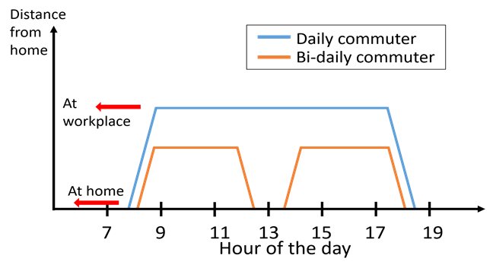
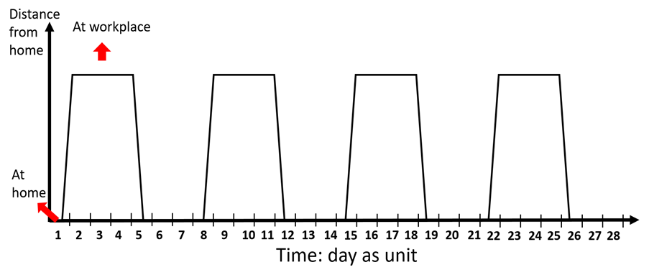
Other works: temporality of commuting
Commuting cycles: rhythms (bi-daily, daily & supra-daily) and respective time frequencies(21.7, 22.6 and 3.2 times per month) => toward a finer estimation of respective traffic quantities
French national HTS “EMP” (Enquête de Mobilité des Personnes) as a 2nd statistical database => national outreach but sample size limitation
Fig.6 Illustration of the 3 types of commuting rhythms.
Left: within-day commuting. Right: overnighter
1
2
3
4
5
Introduction
Methodology
Result
Conclusion
Related work

Slide 19
Frequency and mode share per ring
Short-distance outsiders have a mean weekly commuting frequency of 4.73 trips.
Long-distance outsiders have a mean weekly commuting frequency of 1.33 trips.
The insiders have an average commuting frequency of 4.94 times per week, while for outsiders, it is 2.95 times per week
 | One-way distance(km) |  |  | Frequency | Mode share
Ring | to_IDF | ring_D | ring_O | Weekly | Flow | %Car | %PT
0 | 4.82 | 23.3 | 8.26 | 4.95 | 1,06M | 15% | 64%
1 | 7.47 | 19 | 10.1 | 4.97 | 2,01M | 38% | 49%
2 | 11.8 | 19.9 | 14.2 | 4.92 | 1,71M | 56% | 35%
3 | 19.8 | 16.2 | 22.3 | 4.84 | 603K | 72% | 19%
4 | 39.3 | 15.5 | 24.4 | 4.70 | 144K | 73% | 26%
5 | 89.1 | 14.3 | 17.2 | 3.19 | 84,6K | 59% | 39%
6 | 179 | 14 | 16.8 | 1.52 | 27,0K | 48% | 47%
7 | 412 | 14.2 | 16.1 | 0.92 | 116K | 49% | 45%
All | 20.5 | 15.6 | 15.6 | 4.81 | 5,76M | 44% | 44%
Table_6. Evolution of frequency, mode share of rings
1
2
3
4
5
Introduction
Methodology
Result
Conclusion
Related work

Slide 20
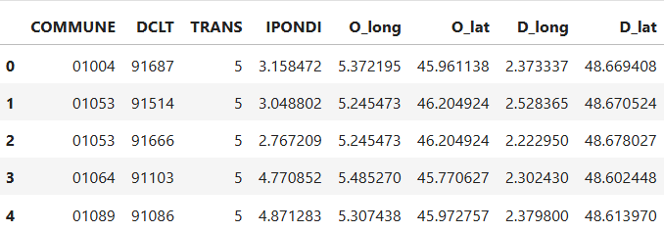
Assignment of road trafic
Take the example of outsider drivers with Essonne as destination
No consideration of temporal aspects: departure time, speed(congestion), frequency etc.
Only 20 OD pairs were depicted
Characterize the trafic: which segment is more travelled? => Discuss the result
Fig.7 Data overview
1
2
3
4
5
Introduction
Methodology
Result
Conclusion
Related work

Slide 21
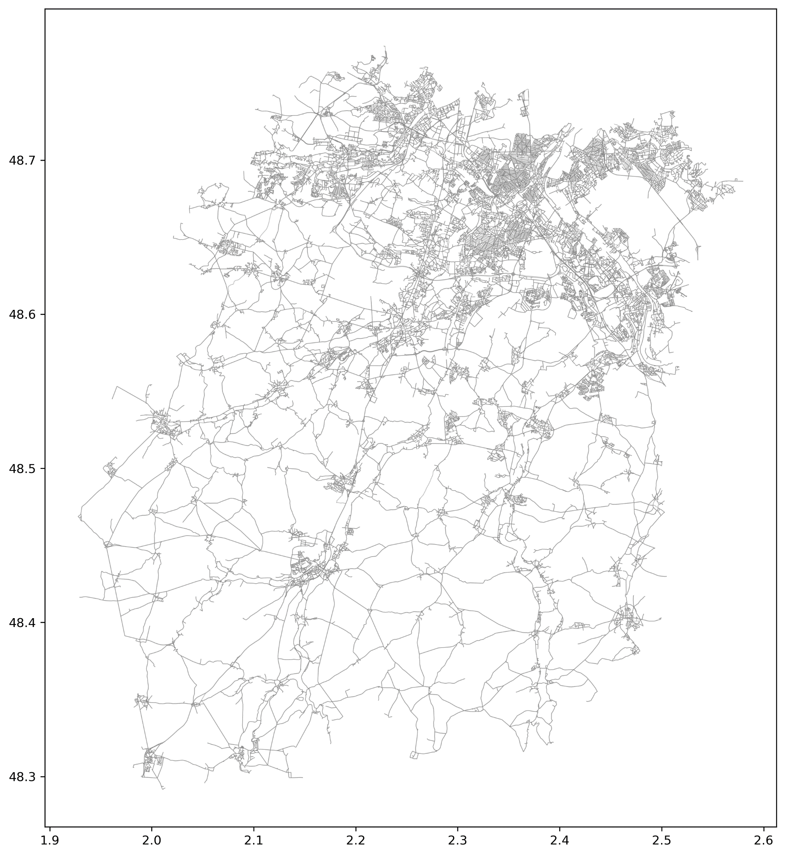
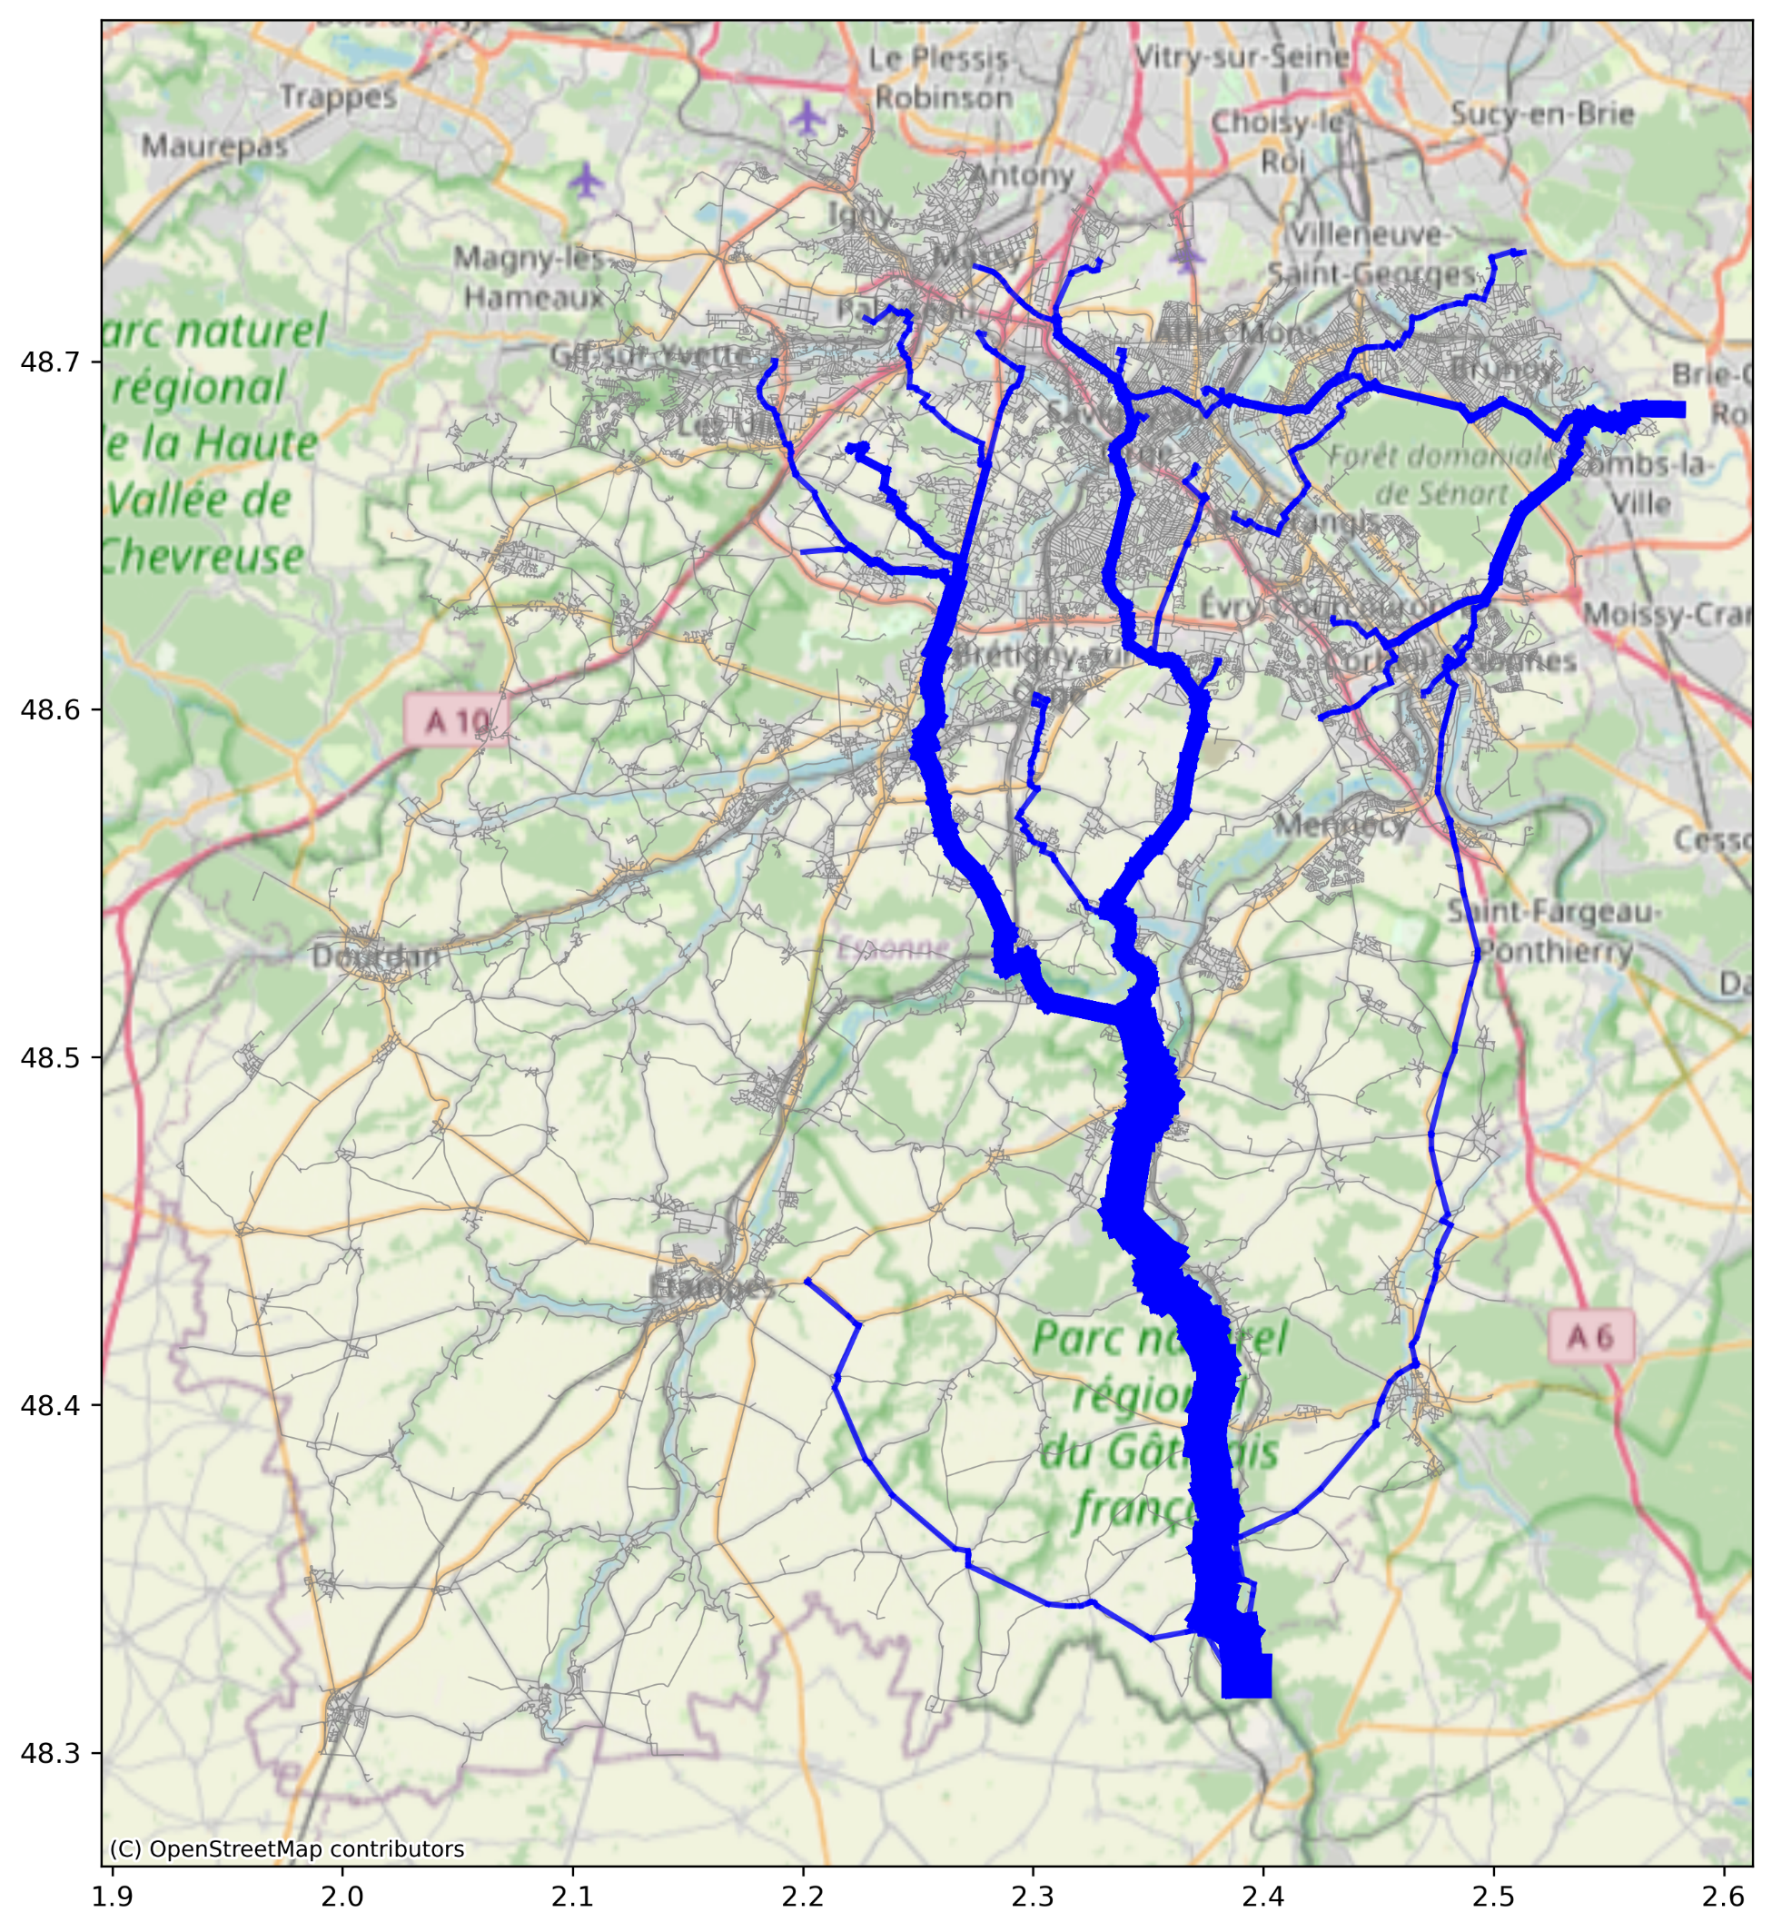
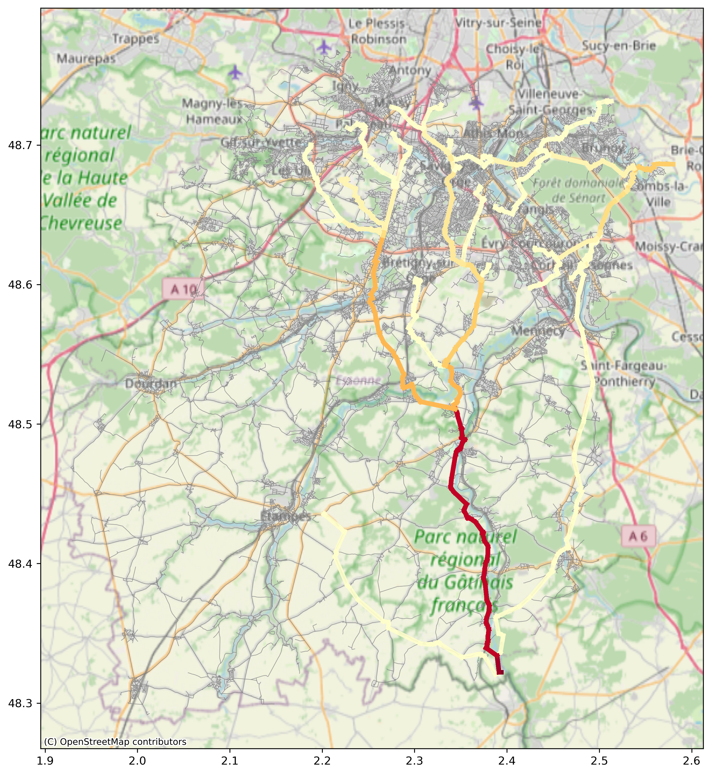
Assignment of road trafic: case of Essonne(91)
Fig.8 (1) road network in Essonne (2) assignment per segment width (3) assignment per color
1
2
3
4
5
Introduction
Methodology
Result
Conclusion
Related work

Slide 22
Thanks! Questions?

